Slide 1

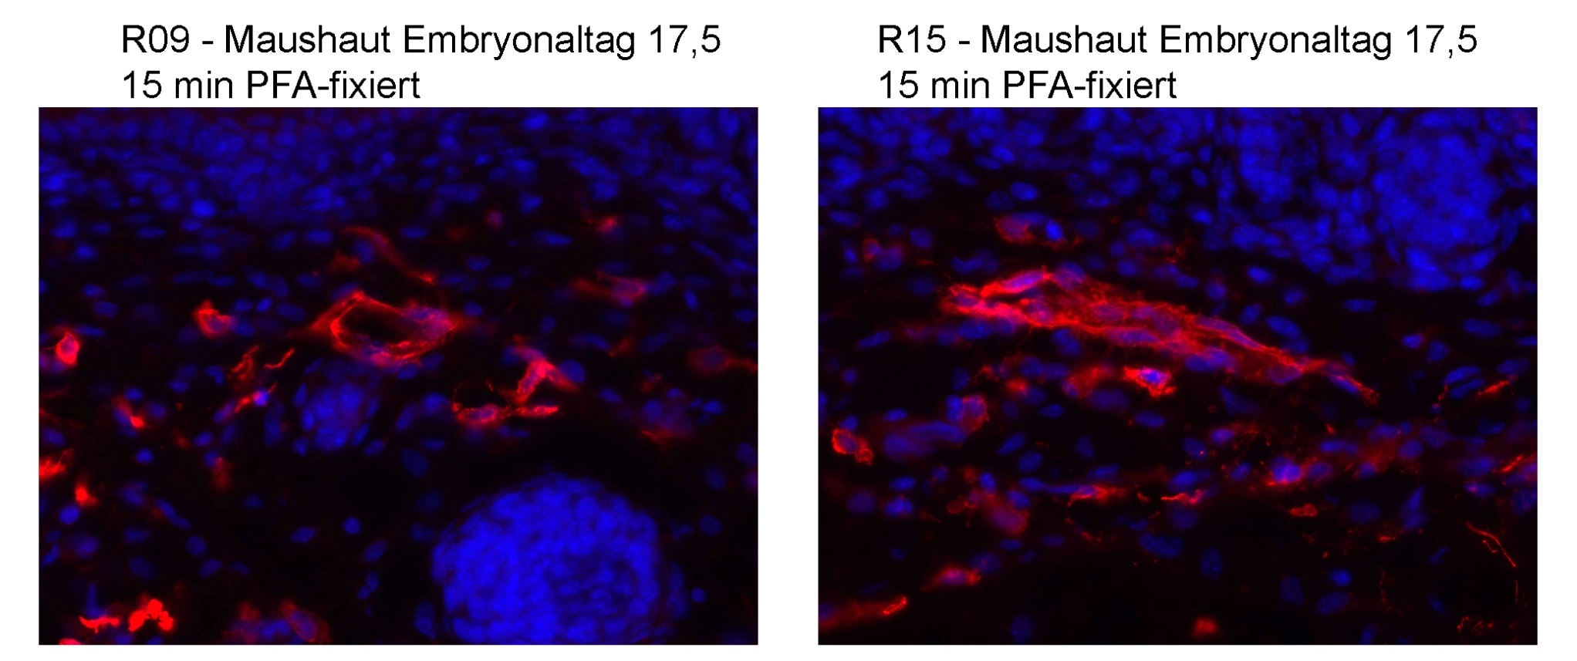
ReliaTech GmbH
Rabbit anti-mouse LYVE-1
(Cat #103-PA50; K24836/K24837; Prot-A)
K22973
K22974
Immunofluorescence staining (red) of cryo-sections of mouse skin day 17.5) (fixed 15 min in PFA) with anti-mouse LYVE-1 (5µg/ml) [Cat# 103-PA50] and counter staining of nuclei with Dapi (blue).
The experiment was performed by the research group of Prof. Dr. J. Wilting and Dr. K. Buttler, University Göttingen, Germany.
http://www.reliatech.de / orders@reliatech.de

